Slide 1
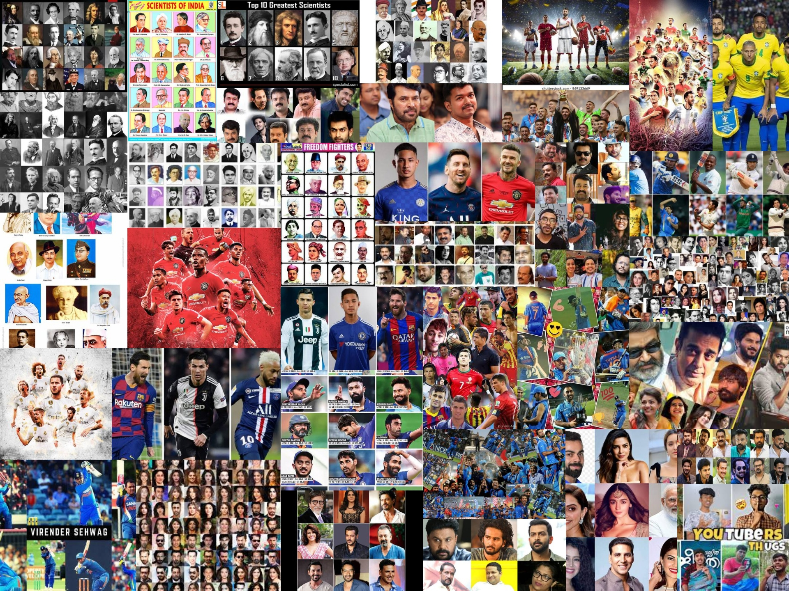
World of celebrities
‎

Slide 2
What do you mean by celebrities
A famous person, especially in entertainment or sport.
Example:-
She/He has been a viral celebrities
Origin:-
It comes from the Latin celebritās , which means, “famous”

Slide 3
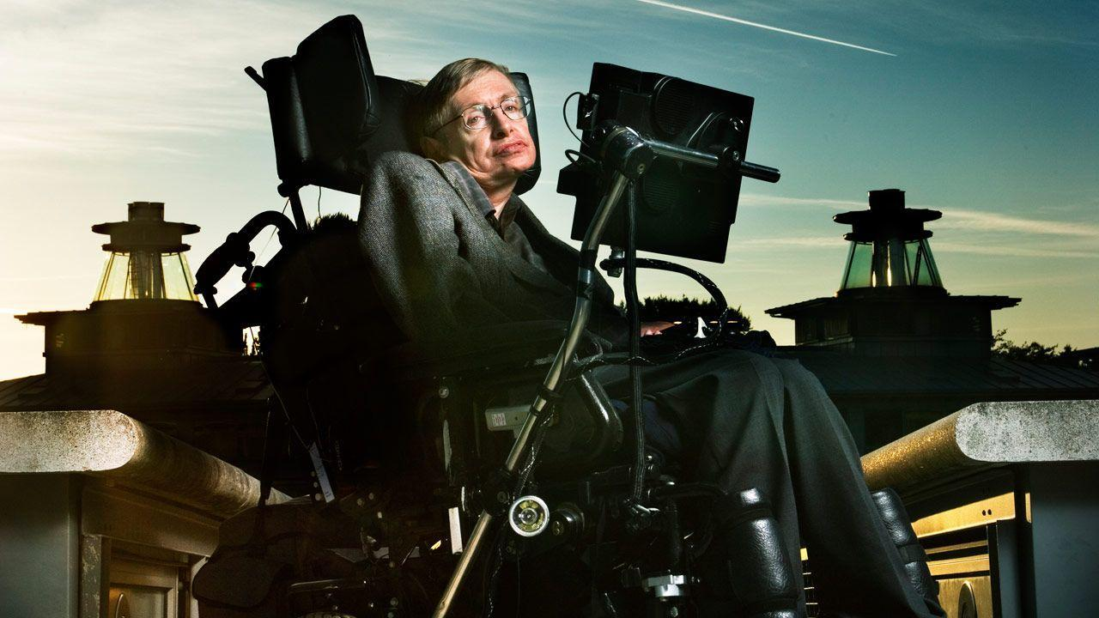
Stephen Hawking

Slide 4
Who was Stephen William Hawking ?
‎

Slide 5
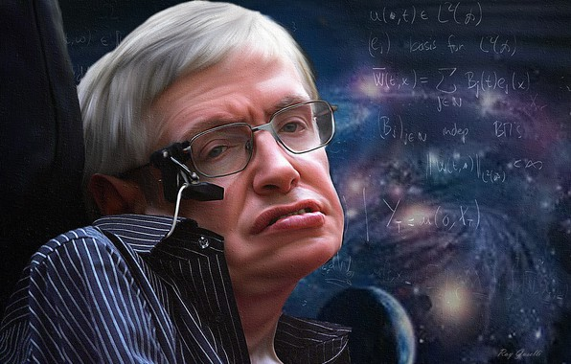
‎
English theoretical physicist
Cosmologist
Author

Slide 6
birth
Stephen William Hawking was born on 8 January, 1942, in Oxford, England. It was exactly three hundred years after the death of Galileo, the father of modern science.

Slide 7
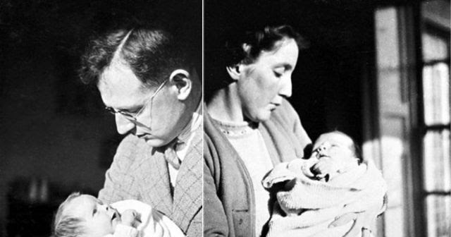
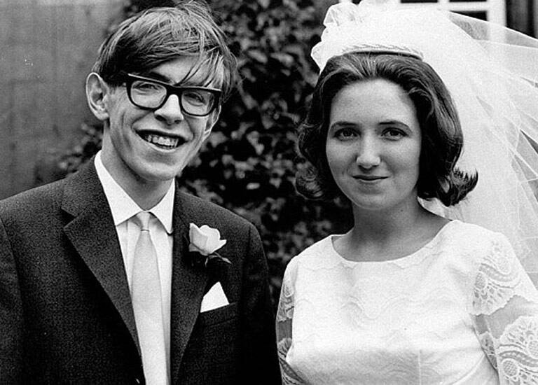
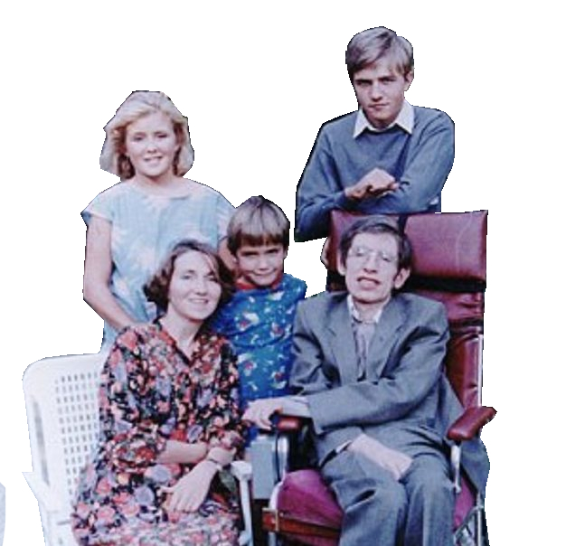
family
.
Parents- Isobel Hawking
- Frank Hawking
Wife - Jane Hawking
Children - Timothy, Robert and Lucy Hawking

Slide 8
Ambition
He dreamed to become scientist.
Frank Hawking encouraged his son to follow him into medicine.

Slide 9
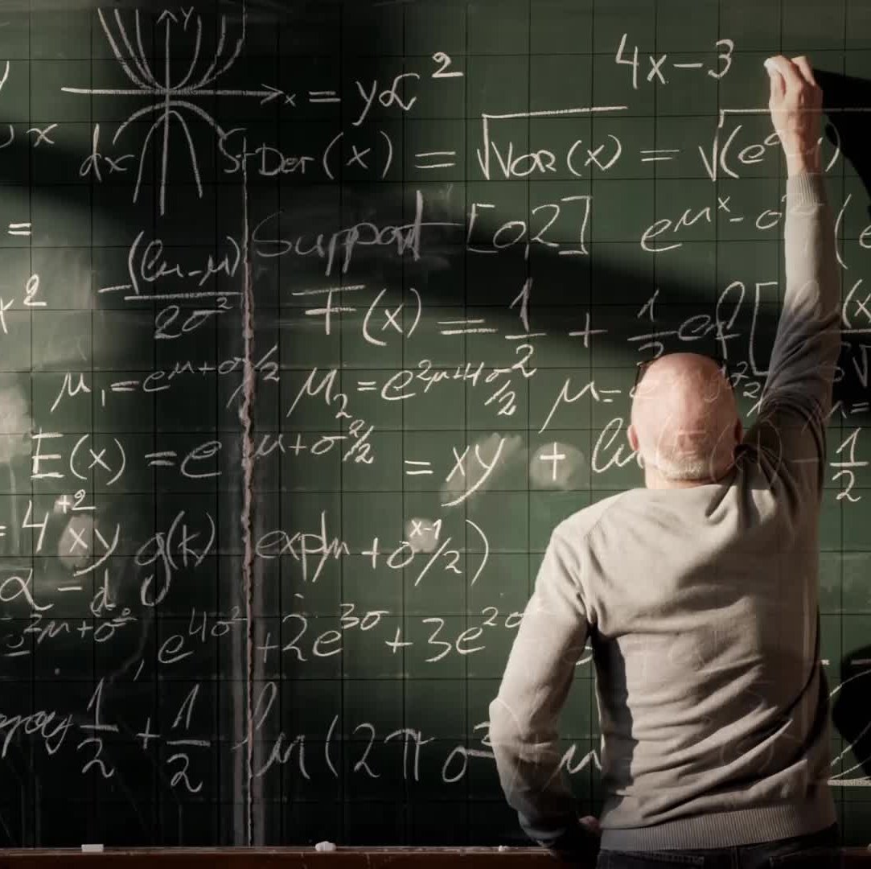
Education
Saint Alban’s High school
University College,Oxford(BA)
Cambridge university (PhD)

Slide 10
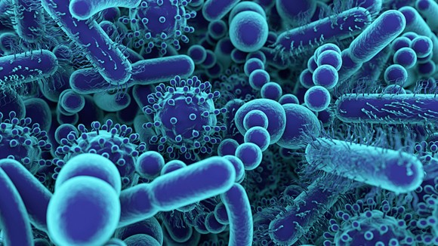
What was his disease?

Slide 11

‎
A rare disease, amyotrophic lateral sclerosis(ALS).
It caused a gradual disintegration of the nerve cells in the spinal cord and the brain.

Slide 12
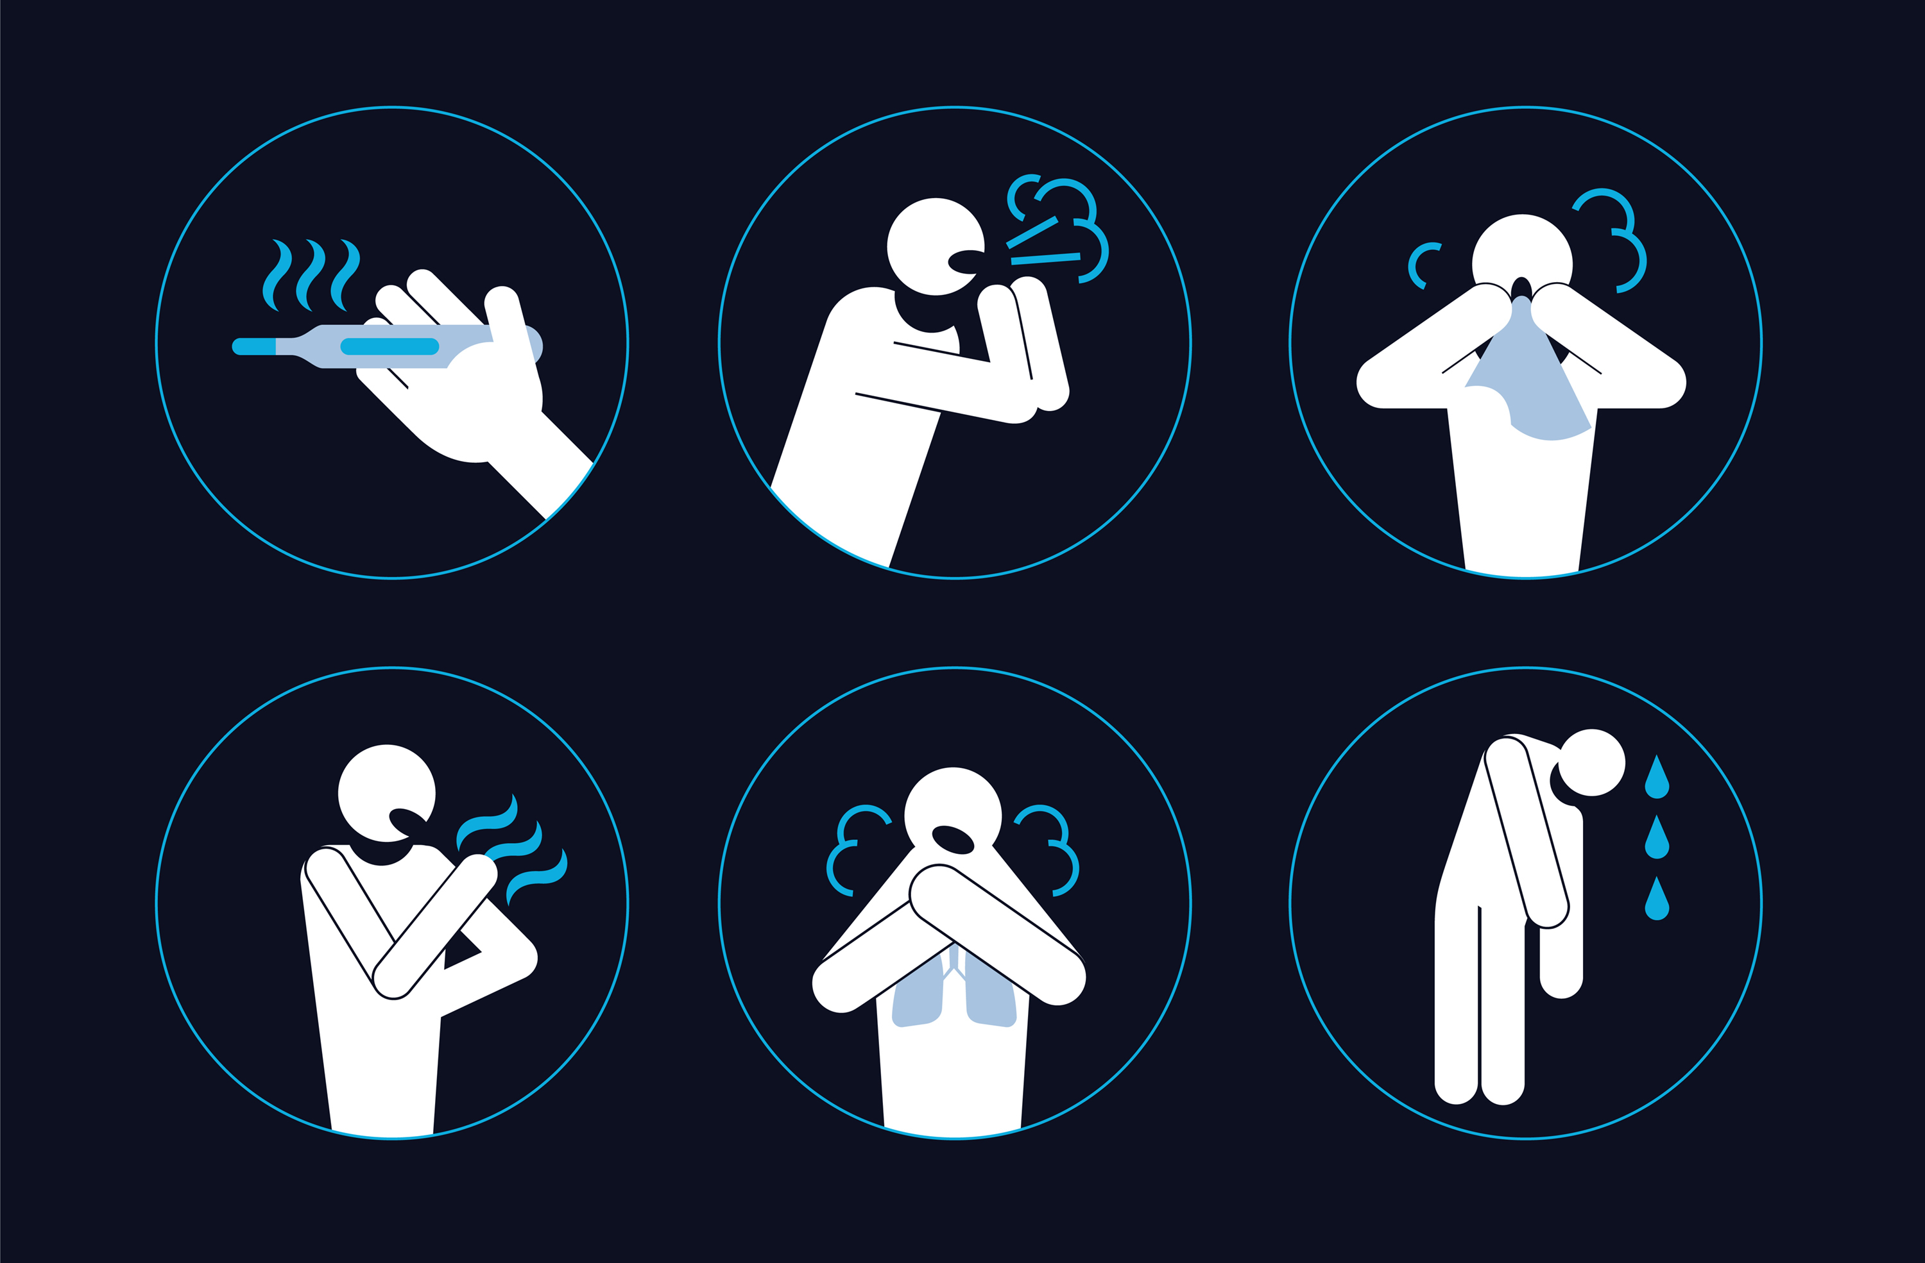
Symptom
Difficulty walking or doing normal daily activities.
Tripping and falling.
Weakness in your legs, feet or ankles.
Difficulty chewing or swallowing.

Slide 13

Overcoming Obstacles
Hawking used a wheelchair and communicated through a speech synthesizer after losing his ability to speak due to his condition.
He also required round-the-clock care and assistance with daily activities.
Despite these challenges, Hawking remained dedicated to his work and continued to make significant contributions to the field of theoretical physics

Slide 14
Discoveries
Laws of Black hole mechanics
Cosmic Inflation Theory
No boundary theory

Slide 15
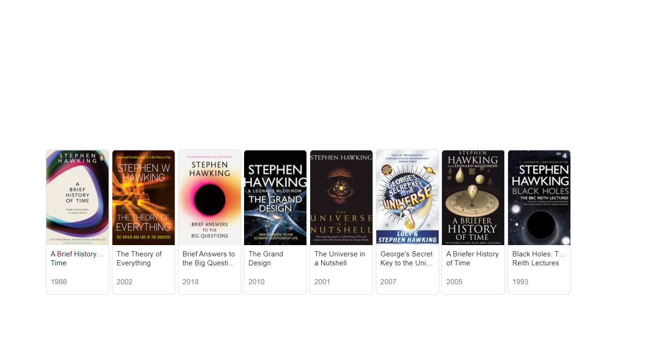
Books
‎

Slide 16

Awards
Albert Einstein Award(1978)
Adams Prize(1966)
Wolf Prize in Physics(1988)

Slide 17
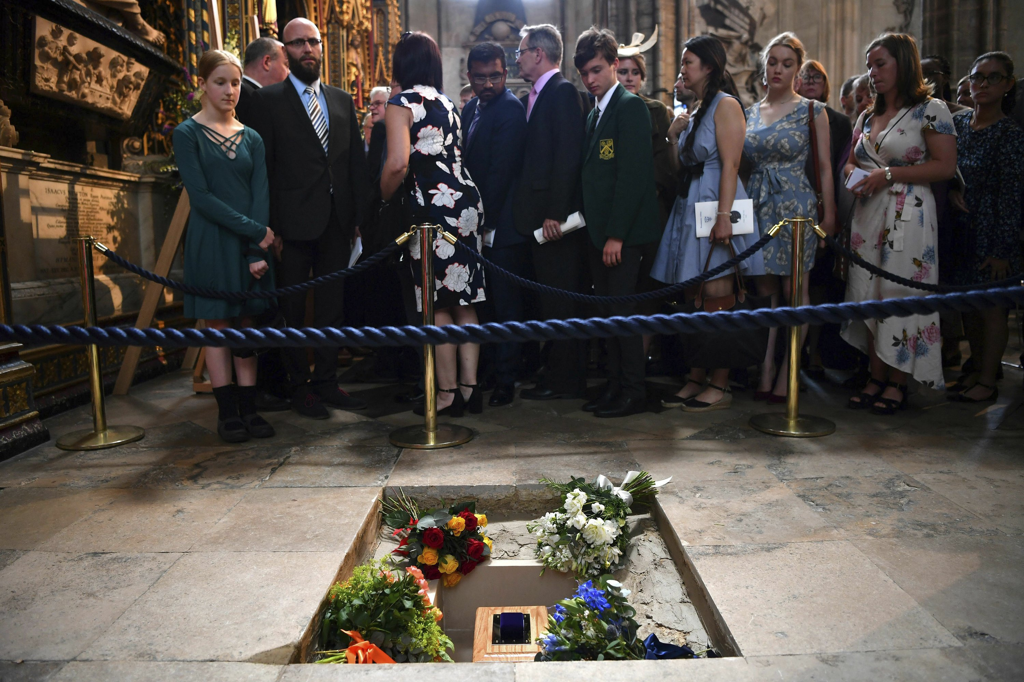
Death
14 March 2018

Slide 18


